Slide 1
Short Notes On Similarity/Dissimilarity Measures
Ng Yen Kaow

Slide 2
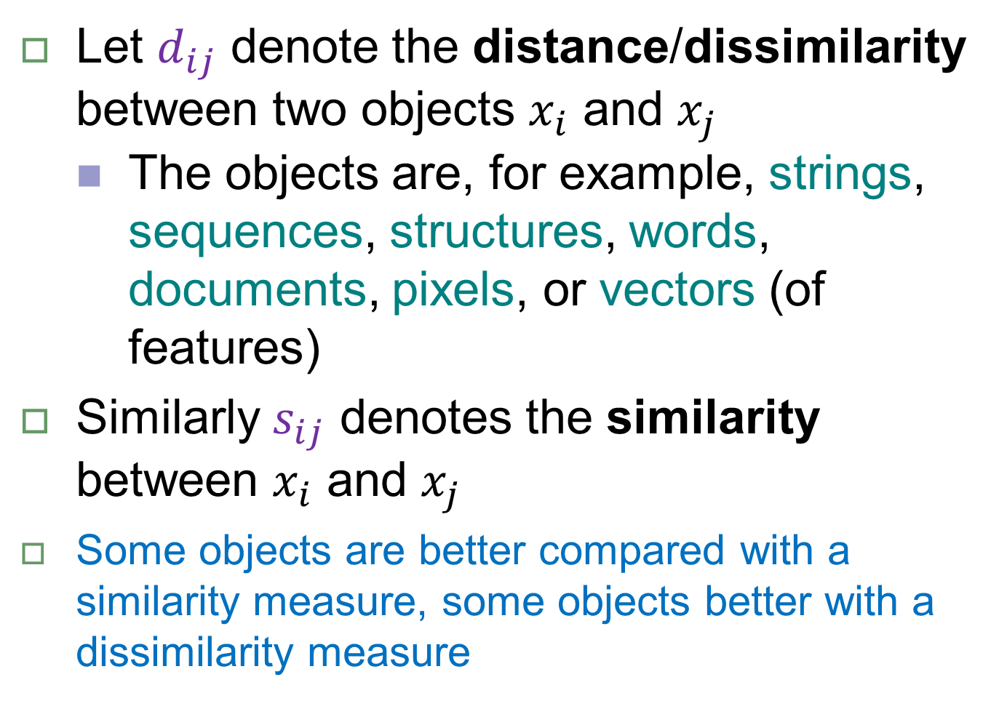
Distance/Dissimilarity & Similarity
Let $d_{ij}$ denote the distance/dissimilarity between two objects $x_{i}$ and $x_{j}$
The objects are, for example, strings, sequences, structures, words, documents, pixels, or vectors (of features)
Similarly $s_{ij}$ denotes the similarity between $x_{i}$ and $x_{j}$
Some objects are better compared with a similarity measure, some objects better with a dissimilarity measure

Slide 3
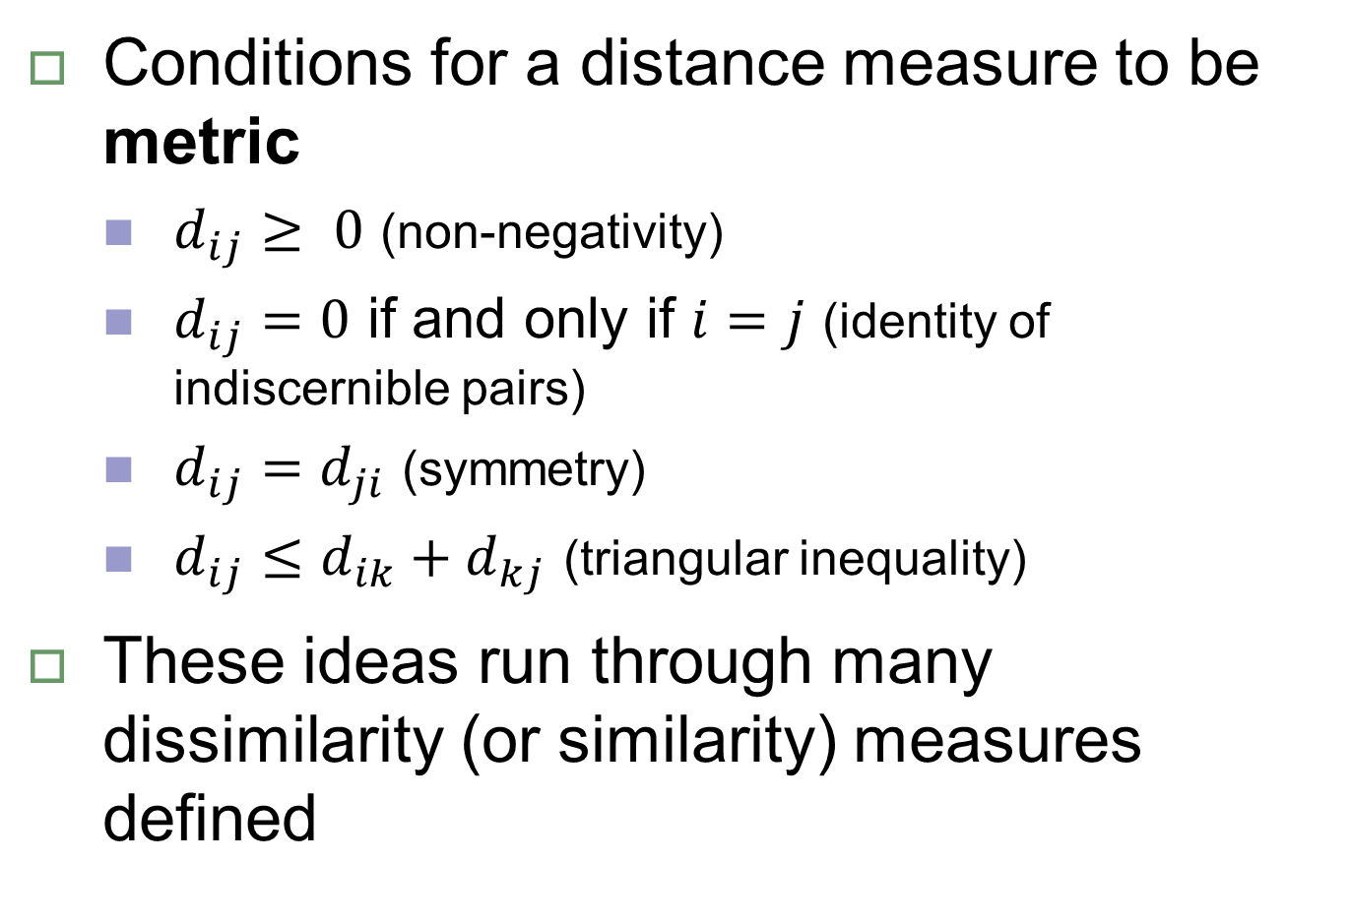
Desirable properties
Conditions for a distance measure to be metric
$d_{ij}≥ 0$ (non-negativity)
$d_{ij}=0$ if and only if $i=j$ (identity of indiscernible pairs)
$d_{ij}=d_{ji}$ (symmetry)
$d_{ij}≤d_{ik}+d_{kj}$ (triangular inequality)
These ideas run through many dissimilarity (or similarity) measures defined

Slide 4
Examples of dissimilarity measures
Strings/Sequences
Hamming distance
Edit distance
Structure
Root Mean Square Deviation (RMSD)
(Feature) vectors
Euclidean distance
Metric/non-metric distance
Similarity measures more commonly used for vectors
Probability distributions
Mutual information
Cross entropy
Kullback-Leibler divergence
All these are metric
Non-metric
In fact, not even symmetric (except MI)

Slide 5
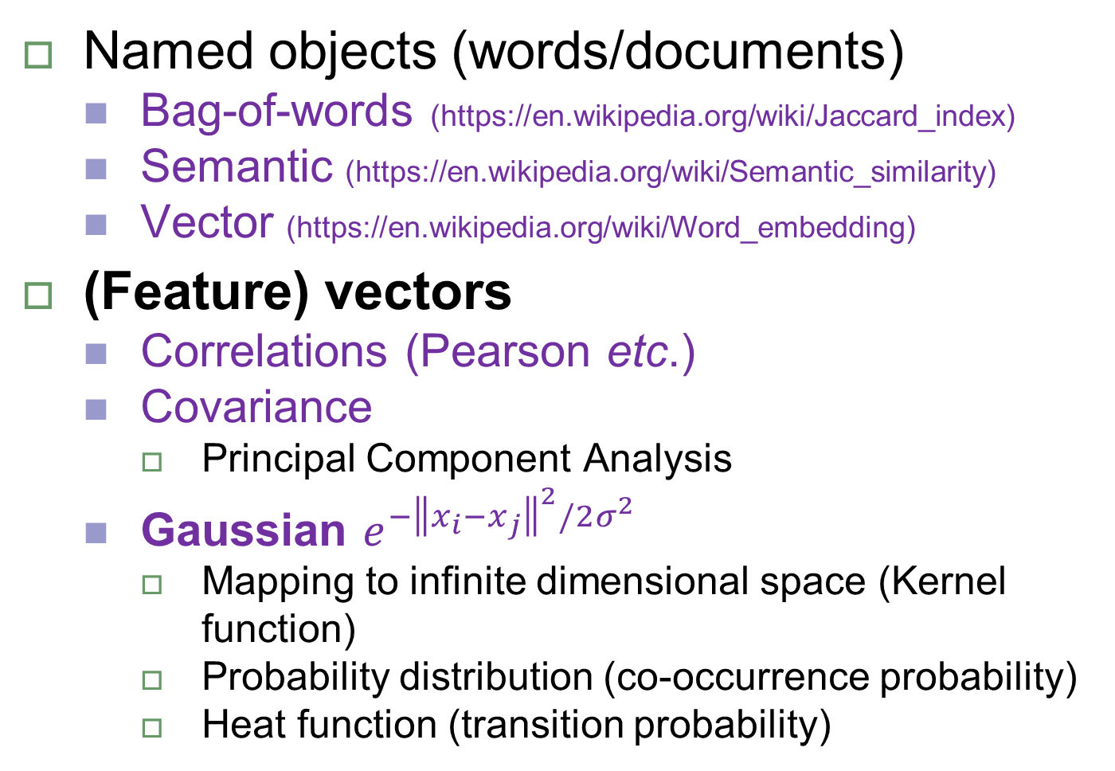
Examples of similarity measures
Named objects (words/documents)
Bag-of-words (https://en.wikipedia.org/wiki/Jaccard_index)
Semantic (https://en.wikipedia.org/wiki/Semantic_similarity)
Vector (https://en.wikipedia.org/wiki/Word_embedding)
(Feature) vectors
Correlations (Pearson etc.)
Covariance
Principal Component Analysis
Gaussian $e^{−{\left\|x_{i}−x_{j}\right\|}^{2}/2σ^{2}}$
Mapping to infinite dimensional space (Kernel function)
Probability distribution (co-occurrence probability)
Heat function (transition probability)

Slide 6
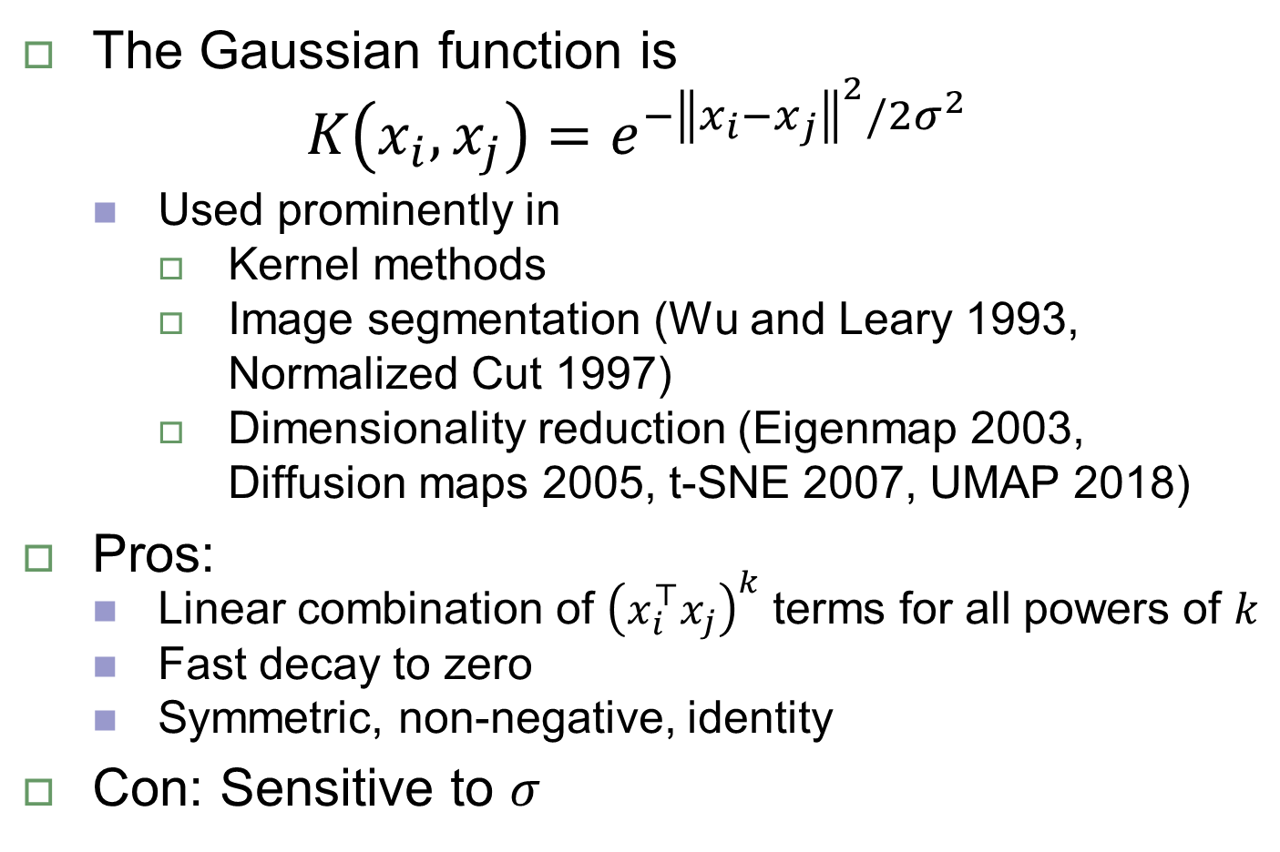
Special mention: Gaussian function
The Gaussian function is
$$K\left(x_{i},x_{j}\right)=e^{−{\left\|x_{i}−x_{j}\right\|}^{2}/2σ^{2}}$$
Used prominently in
Kernel methods
Image segmentation (Wu and Leary 1993, Normalized Cut 1997)
Dimensionality reduction (Eigenmap 2003, Diffusion maps 2005, t-SNE 2007, UMAP 2018)
Pros:
Linear combination of ${\left(x_{i}^{⊤}x_{j}\right)}^{k}$ terms for all powers of $k$
Fast decay to zero
Symmetric, non-negative, identity
Con: Sensitive to $σ$

Slide 7

How to convert $d_{ij}⇔s_{ij}$

Slide 8
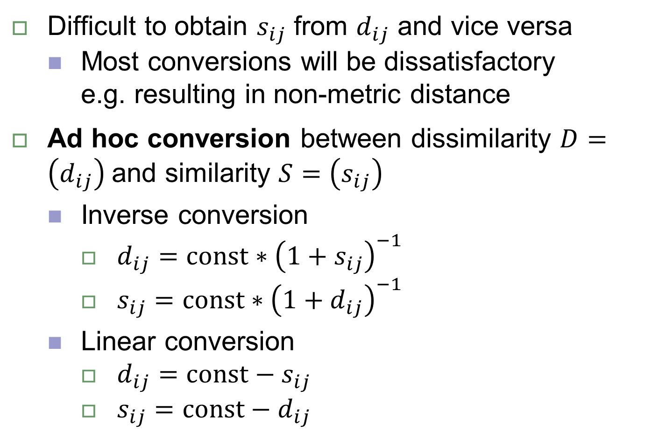

Converting $d_{ij}⇔s_{ij}$
Difficult to obtain $s_{ij}$ from $d_{ij}$ and vice versa
Most conversions will be dissatisfactory e.g. resulting in non-metric distance
Ad hoc conversion between dissimilarity $D=\left(d_{ij}\right)$ and similarity $S=\left(s_{ij}\right)$
Inverse conversion
$d_{ij}=const∗{\left({1+s}_{ij}\right)}^{−1}$
$s_{ij}=const∗{\left({1+d}_{ij}\right)}^{−1}$
Linear conversion
$d_{ij}=const−s_{ij}$
$s_{ij}=const−d_{ij}$
Set const to 1 or decide its value by requiring a condition (e.g. maximum value)

Slide 9
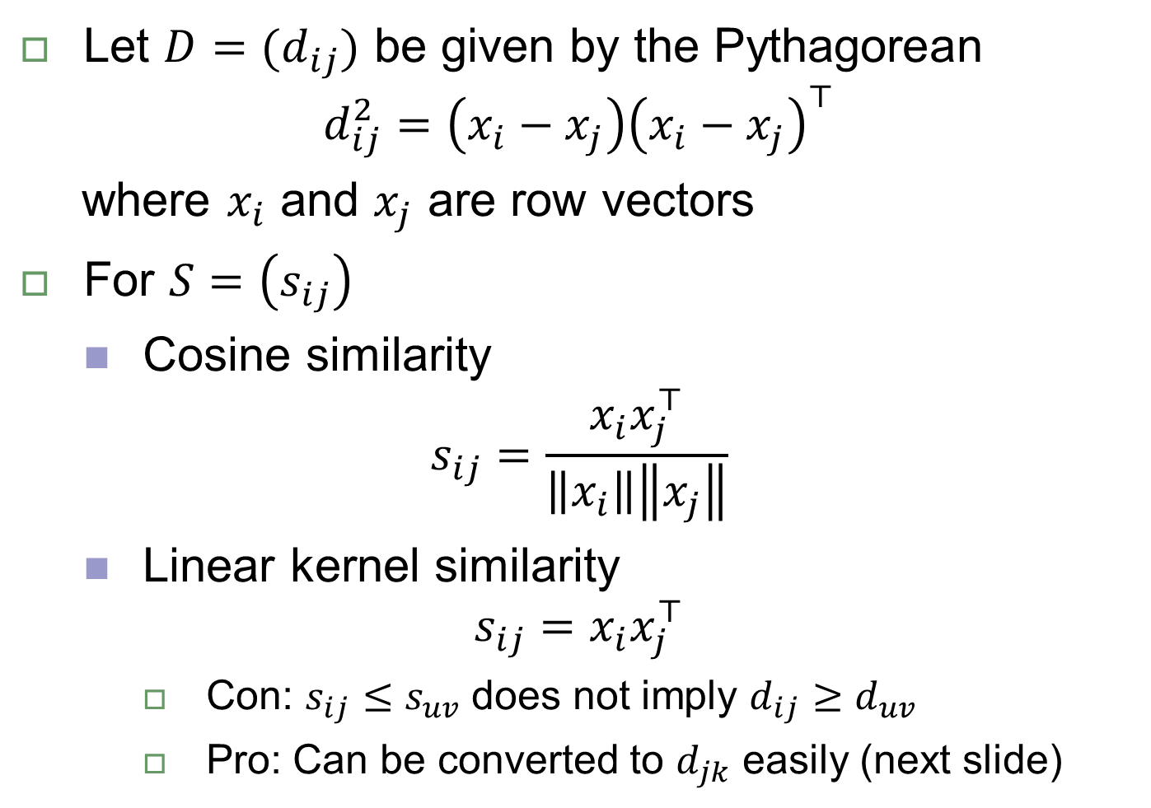

Euclidean distance $d_{ij}⇔s_{ij}$
Let ${D=(d}_{ij})$ be given by the Pythagorean
$${d_{ij}^{2}=\left(x_{i}−x_{j}\right)\left(x_{i}−x_{j}\right)}^{⊤}$$
where $x_{i}$ and $x_{j}$ are row vectors
For $S=\left(s_{ij}\right)$
Cosine similarity
$$s_{ij}=\frac{x_{i}x_{j}^{⊤}}{\left\|x_{i}\right\|\left\|x_{j}\right\|}$$
Linear kernel similarity
$$s_{ij}=x_{i}x_{j}^{⊤}$$
Con: $s_{ij}≤s_{uv}$ does not imply $d_{ij}≥d_{uv}$
Pro: Can be converted to $d_{jk}$ easily (next slide)

Slide 10
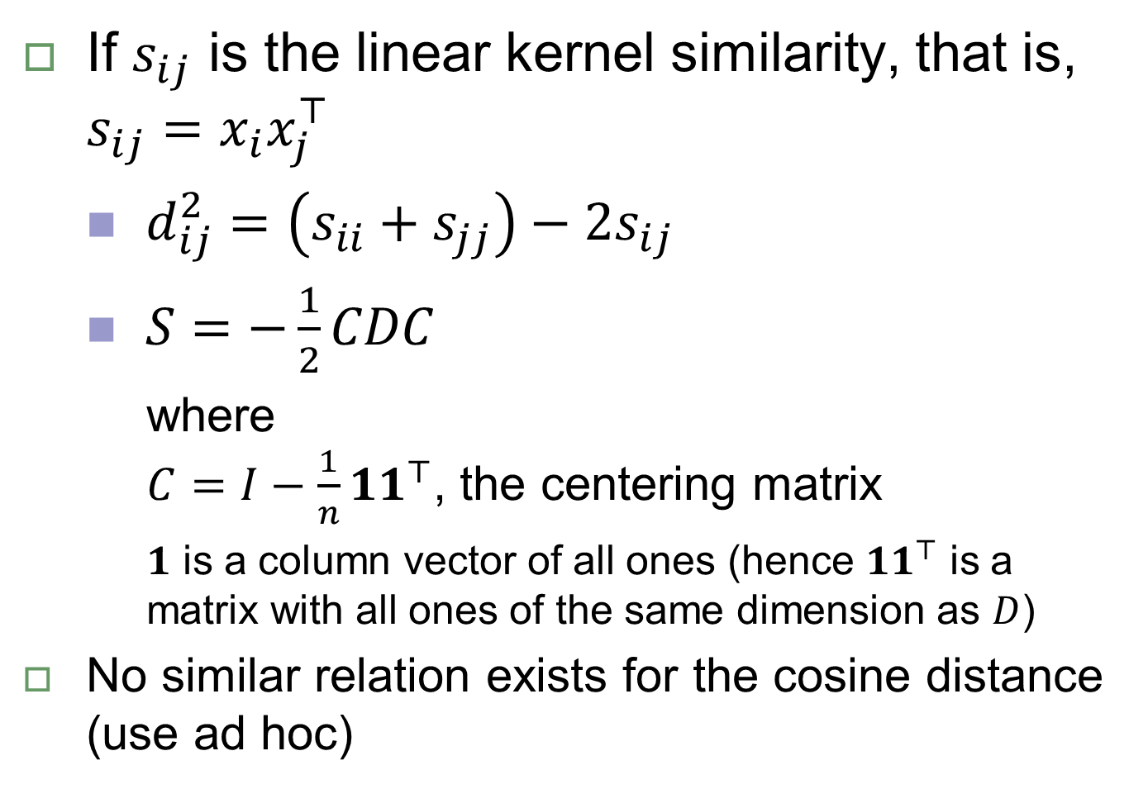
Euclidean distance $d_{ij}⇔s_{ij}$
If $s_{ij}$ is the linear kernel similarity, that is, $s_{ij}=x_{i}x_{j}^{⊤}$
$d_{ij}^{2}=\left(s_{ii}+s_{jj}\right)−2s_{ij}$
$S=−\frac{1}{2}CDC$
where $C=I−\frac{1}{n}{11}^{⊤}$, the centering matrix
$1$ is a column vector of all ones (hence ${11}^{⊤}$ is a matrix with all ones of the same dimension as $D$)
No similar relation exists for the cosine distance (use ad hoc)

Slide 11
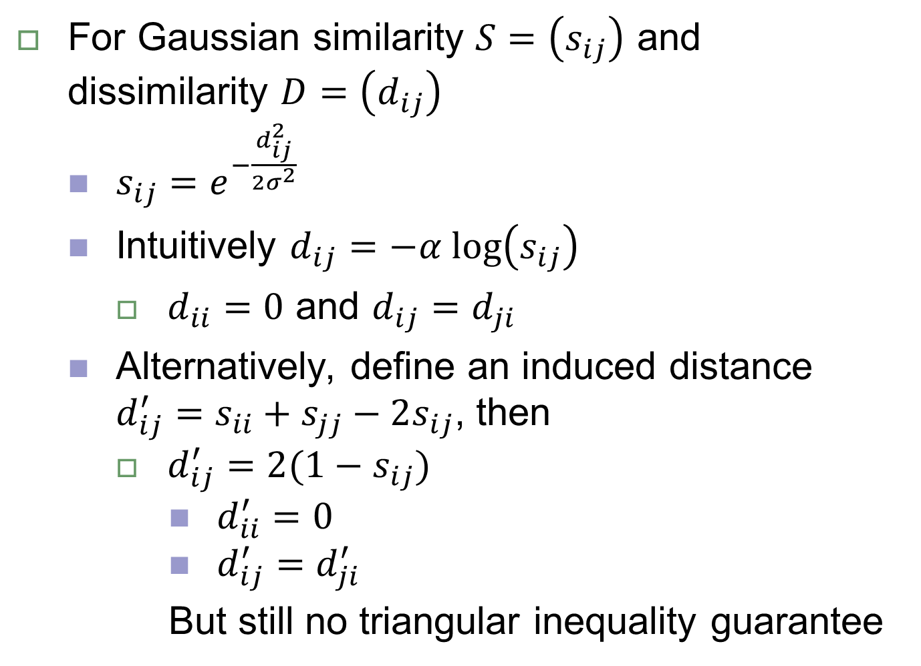

Gaussian similarity $s_{ij}⇔d_{ij}$
For Gaussian similarity $S=\left(s_{ij}\right)$ and dissimilarity $D=\left(d_{ij}\right)$
$s_{ij}=e^{−\frac{d_{ij}^{2}}{2σ^{2}}}$
Intuitively $d_{ij}=−α log\left(s_{ij}\right)$
$d_{ii}=0$ and $d_{ij}=d_{ji}$
Alternatively, define an induced distance $d_{ij}^{′}=s_{ii}+s_{jj}−2s_{ij}$, then
$d_{ij}^{′}=2(1−s_{ij})$
$d_{ii}^{′}=0$
$d_{ij}^{′}=d_{ji}^{′}$
But still no triangular inequality guarantee

